Slide 1

CAP 6317/4773: Social Media Mining
Lecture 16: Data Mining
Raiyan Abdul Baten, Ph.D.
March 5, 2024

Slide 2
Recap

Slide 3
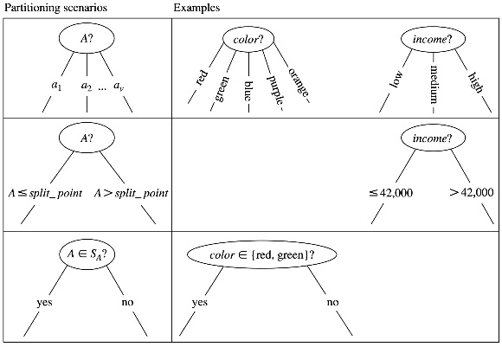
Decision Trees
The attribute is discrete-valued:
A branch is created for each value
The attribute is continuous-valued:
Split values along split points
The attribute is discrete-valued and a binary tree must be produced:
Split values along yes/no questions

Slide 4
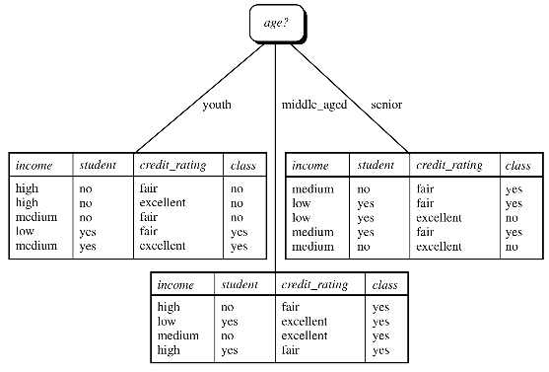
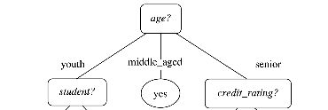
Decision Trees

Slide 5


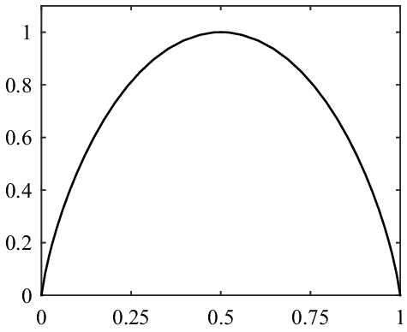
S
p(X=heads)

Slide 6
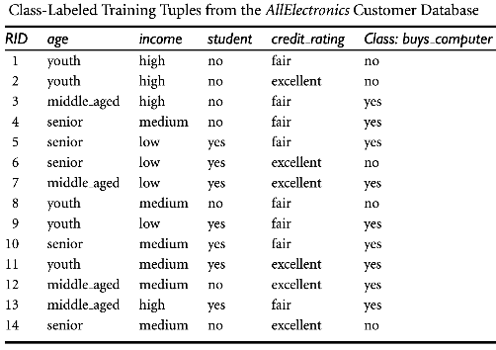

Decision Trees
Step 1:
Calculate the entropy of the class labels in the entire dataset, D. This is the expected amount of information needed to classify a tuple in D.

Slide 7


Decision Trees
Step 2:
We’re interested to see which feature has the ‘purest’ split of D.
To check this, we will calculate the Information Gain for every feature (age, income, student status, credit rating)
We will split the tree using the feature with the most Information Gain.
Expected amount of information needed to classify a tuple in D
Expected amount of information needed to classify a tuple in D based on the partitioning by feature A. If the partition is pure, Info_{A}(D) is low, which means Gain(A) is high

Slide 8
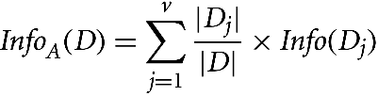
Decision Trees
Out of all tuples in the dataset, count how many tuples fall into the j^{th} branch
Expected amount of information needed to classify a tuple in D based on the partitioning by feature A.
The purity of the j^{th} branch
Sum over all branches of feature A. For example, the feature Age has three branches, youth, middle_aged, and senior

Slide 9
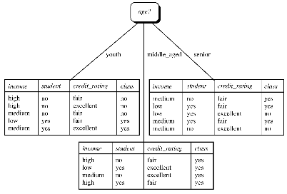
Decision Trees
Step 2 (cont’d):
Gain (Age) = Info(D) - Info_{Age}(D)
= 0.940 - 0.694 = 0.246
Gain (income) = 0.029
Gain (student) = 0.151
Gain (credit_rating) = 0.048
Decision: Split along ‘Age’ first since it leads to the purest outcomes!

Slide 10
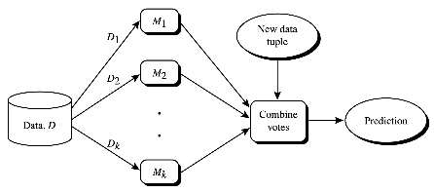
Ensemble Methods
Multiple models are trained on subsets of the original dataset. Given a new test datapoint, the models ‘vote’ their classification results. Majority votes determine the final prediction.

Slide 11
Ensemble Methods
Three major variations:
Bagging
Random Forests
Boosting

Slide 12

Bootstrap Aggregation: Bagging
Randomly sample d data points with replacement out of D. The same data point can appear multiple times, while some data points can get left out. Each of the k models sees a slightly different training dataset.

Slide 13
Random Forest
Now the classifiers must use the Decision Tree algorithm. Each node in the decision tree can use only a small number of features (randomly selected out of all available features) to determine the splitting feature. The process is repeated for each of the k models.

Slide 14
Reminder to self: Attendance

Slide 15
Group Projects

Slide 16
Supervised Learning

Slide 17
Boosting: AdaBoost
Two major changes:
Weights are assigned to each data point
Goal: Give more attention to the ‘harder’ data points

Slide 18
Boosting: AdaBoost
Two major changes:
Weights are assigned to each data point
Goal: Give more attention to the ‘harder’ data points
Weights are assigned to each model
Goal: Give more attention to the better performing models
Voting is not democratic any more – if you’re a better performer, you vote matters more

Slide 19

Boosting: AdaBoost
Iteratively fit the models in the ensemble:
Start with the same weight of 1/d for all data points

Slide 20
Boosting: AdaBoost
Iteratively fit the models in the ensemble:
Start with the same weight of 1/d for all data points
Sample with replacement, but the sampled dataset can be of any size

Slide 21
Boosting: AdaBoost
Iteratively fit the models in the ensemble:
Start with the same weight of 1/d for all data points
Sample with replacement, but the sampled dataset can be of any size
Each datapoint is equally likely to be picked

Slide 22
Boosting: AdaBoost
Iteratively fit the models in the ensemble:
Start with the same weight of 1/d for all data points
Sample with replacement, but the sampled dataset can be of any size
Each datapoint is equally likely to be picked
After a classifier, M_{i} , is trained:
Assign the model a weight based on its accuracy

Slide 23
Boosting: AdaBoost
Iteratively fit the models in the ensemble:
Start with the same weight of 1/d for all data points
Sample with replacement, but the sampled dataset can be of any size
Each datapoint is equally likely to be picked
After a classifier, M_{i} , is trained:
Assign the model a weight based on its accuracy
Increase weights of misclassified data points, decrease weights of correctly classified data points

Slide 24
Boosting: AdaBoost
Iteratively fit the models in the ensemble:
Start with the same weight of 1/d for all data points
Sample with replacement, but the sampled dataset can be of any size
Each datapoint is equally likely to be picked
After a classifier, M_{i} , is trained:
Assign the model a weight based on its accuracy
Increase weights of misclassified data points, decrease weights of correctly classified data points
For the next model M_{i+1} , use weighted sampling to preferentially pick the misclassified data points

Slide 25
Boosting: AdaBoost
Significantly improves accuracy over a single model fitted on the entire dataset
Not robust to overfitting

Slide 26
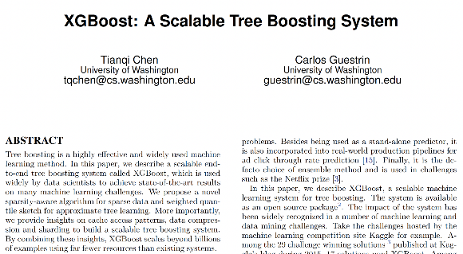
XGBoost is a clever implementation of Tree Boosting
Efficient regularization (both LASSO and Ridge),
Better parallel processing, cache access, data compression
Better handling of sparse data
The core principles and intuitions behind tree ensembling are exactly the same

Slide 27
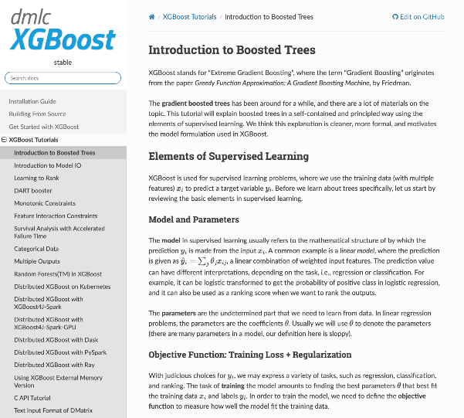

Slide 28
Regression Modeling
Classification Modeling
Linear regression – Ridge
Linear regression – LASSO
ElasticNet regression
Bayesian regression
Support Vector regression (SVR)
Random Forest
AdaBoost
XGBoost
Naive Bayes
K-NN
Logistic Regression
Support Vector Machine (SVM)
Random Forest
AdaBoost
XGBoost

Slide 29
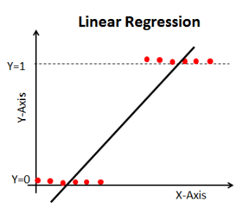
Logistic Regression

Slide 30

Logistic Regression

Slide 31
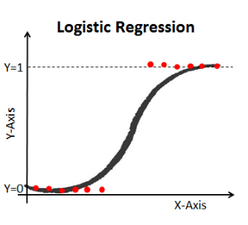
Logistic Regression

Slide 32
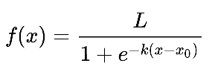
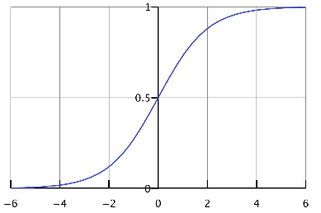
Logistic Regression: The Logistic Function
L = 1, k = 1, x₀ = 0
f(x)
x₀ determines the x value of the function’s midpoint
L is a scaling factor
k determines the steepness of the curve
x

Slide 33

Logistic Regression

Slide 34
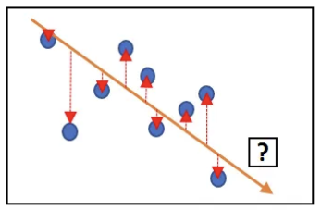



Recap: Simple Linear Regression
We want to learn w₀ and w₁. Consider the i-th data point,
The residual sum of squares, RSS, is given by,
We want to find w₀ and w₁ that minimize the RSS:

Slide 35
Logistic Regression: Cross Entropy Loss
Properties we desire:
When predicted P(y_{i} = 1 | x_{i}) = 1 and ground truth label y_{i} = 1
Great job! We want loss = 0

Slide 36
Logistic Regression: Cross Entropy Loss
Properties we desire:
When predicted P(y_{i} = 1 | x_{i}) = 1 and ground truth label y_{i} = 1
Great job! We want loss = 0
When predicted P(y_{i} = 1 | x_{i}) = 0 and ground truth label y_{i} = 0
Great job! We want loss = 0

Slide 37
Logistic Regression: Cross Entropy Loss
Properties we desire:
When predicted P(y_{i} = 1 | x_{i}) = 1 and ground truth label y_{i} = 1
Great job! We want loss = 0
When predicted P(y_{i} = 1 | x_{i}) = 0 and ground truth label y_{i} = 0
Great job! We want loss = 0
When ground truth label y_{i} = 0 but predicted P(y_{i} = 1 | x_{i}) → 1
Yikes, we want loss → infinity
When ground truth label y_{i} = 1 but predicted P(y_{i} = 1 | x_{i}) → 0
Yikes, we want loss → infinity

Slide 38

Logistic Regression: Cross Entropy Loss
Let
Cross entropy loss,

Slide 39
Logistic Regression: Cross Entropy Loss
When predicted P(y_{i} = 1 | x_{i}) = p_{i} = 1 and ground truth label y_{i} = 1
Great job! We want loss = 0
p_{i} = 1 makes this term 0
y_{i} = 1 makes this term 0

Slide 40
Logistic Regression: Cross Entropy Loss
When predicted P(y_{i} = 1 | x_{i}) = p_{i} = 0 and ground truth label y_{i} = 0
Great job! We want loss = 0
y_{i} = 0 makes this term 0
p_{i} = 0 makes this term log 1 = 0

Slide 41
Logistic Regression: Cross Entropy Loss
When ground truth label y_{i} = 0 but predicted P(y_{i} = 1 | x_{i}) = p_{i} → 1
Yikes, we want loss → infinity
As p_{i} → 1, this term goes towards inf
For instance, when p_{i} =0.99,
l_{i} = - log 0.01 = 2, which is a positive number. As p_{i} gets even closer to 1, the loss also increases
y_{i} = 0 makes this term 0

Slide 42
Logistic Regression: Cross Entropy Loss
When ground truth label y_{i} = 1 but predicted P(y_{i} = 1 | x_{i}) = p_{i} → 0
Yikes, we want loss → infinity
p_{i} → 0 makes this term grow to infinity, like the previous slide
y_{i} = 1 makes this term 0

Slide 43

Logistic Regression

Slide 44


Naive Bayes Classification
Data point x belongs to the class C_{i} if and only if the probability of the data point belonging to any other class is lower:

Slide 45
Naive Bayes Classification
Data point x belongs to the class C_{i} if and only if the probability of the data point belonging to any other class is lower:
We have a total of m classes

Slide 46
Naive Bayes Classification
Data point x belongs to the class C_{i} if and only if the probability of the data point belonging to any other class is lower:
We don’t really care about the actual probabilities. We just need to know enough to make the comparisons

Slide 47
Naive Bayes Classification
Data point x belongs to the class C_{i} if and only if the probability of the data point belonging to any other class is lower:

Slide 48

Naive Bayes Classification
Data point x belongs to the class C_{i} if and only if the probability of the data point belonging to any other class is lower:

Slide 49
Naive Bayes Classification
Data point x belongs to the class C_{i} if and only if the probability of the data point belonging to any other class is lower:
We want to find C_{i} such that P(C_{i} | x) is maximized

Slide 50
Naive Bayes Classification
Data point x belongs to the class C_{i} if and only if the probability of the data point belonging to any other class is lower:
P(x) is the same for all classes, so it won’t affect the probability comparisons. We can consider it a constant

Slide 51
Naive Bayes Classification
Data point x belongs to the class C_{i} if and only if the probability of the data point belonging to any other class is lower:
Out of all data points, how many belong to class C_{i}?

Slide 52
Naive Bayes Classification
Data point x belongs to the class C_{i} if and only if the probability of the data point belonging to any other class is lower:
This one’s tricky…

Slide 53
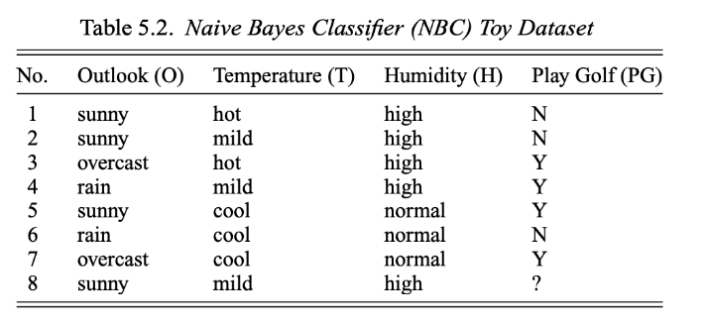
7 ‘training’ data points
1 ‘test’ data point

Slide 54
There are only two classes, Y and N.
If
P(PG=Y) > P(PG=N) for the test datapoint, predict output class Y

Slide 55
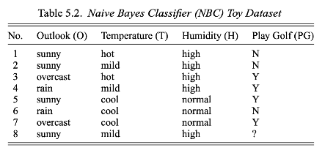

Compare P( PG = Y | i₈ ) and P( PG = N | i₈ )

Slide 56
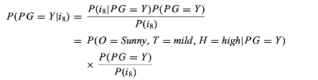
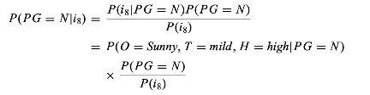
Compare P( PG = Y | i₈ ) and P( PG = N | i₈ )

Slide 57
Compare P( PG = Y | i₈ ) and P( PG = N | i₈ )
Just plugging in the feature values of i₈

Slide 58
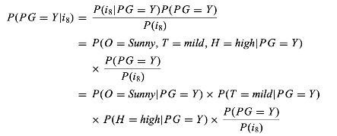
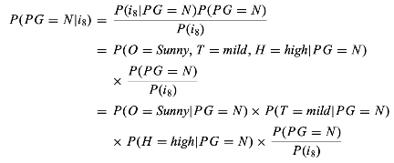
Compare P( PG = Y | i₈ ) and P( PG = N | i₈ )

Slide 59
Compare P( PG = Y | i₈ ) and P( PG = N | i₈ )
The naive assumption! We are assuming that all features are independent of each other (which is clearly not the case in the real world). If the features are independent, then their joint probability can be broken down as a multiplication of the individual probabilities

Slide 60
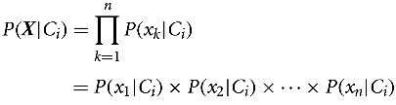
Naive Bayes Classification
If the features are naively assumed to be independent of one another, then their joint probability is simply the multiplication of the individual probabilities.

Slide 61
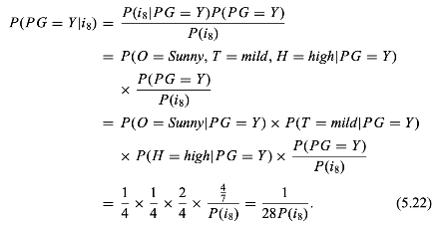
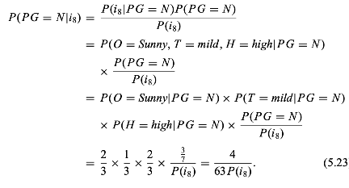
Compare P( PG = Y | i₈ ) and P( PG = N | i₈ )

Slide 62
Compare P( PG = Y | i₈ ) and P( PG = N | i₈ )
P( PG = N | i₈ ) is higher, so the predicted class is PG = N

Slide 63
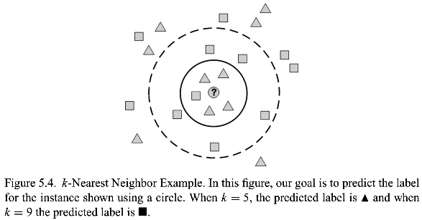
k-NN Classification

Slide 64
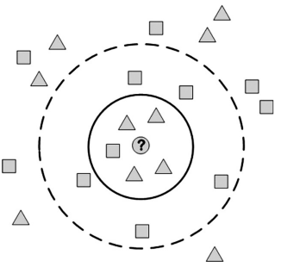
k-NN Classification
x₂
If the feature are numeric, Euclidean distance may be reasonable to use!
For 5-NN, find the 5 data points with the lowest Euclidean distance from the target data point, and do majority voting to decide the predicted class.
x₁

Slide 65
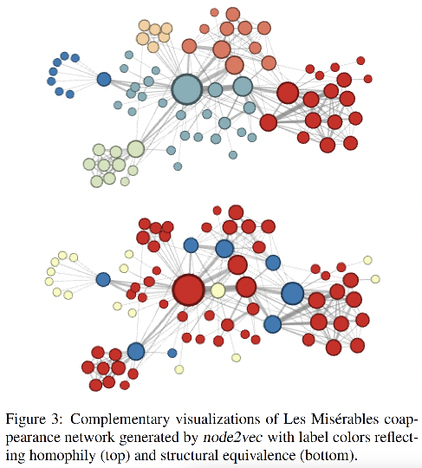
Which nodes are similar to each other?

Slide 66
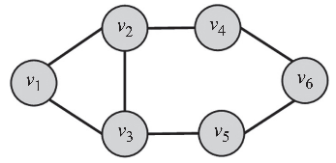
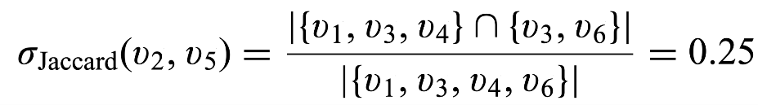
Capturing Structural Equivalence
N(v₂) = {v₁, v₃, v₄}
N(v₅) = {v₃, v₆}

Slide 67
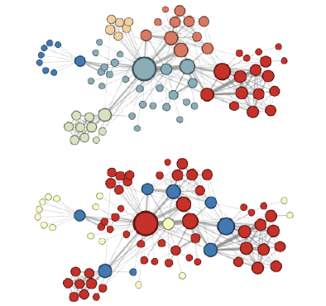
k-NN Classification
You can do k-NN classification on graphs as well!
Instead of Euclidean distance, use Jaccard similarity!
Find the 5 most similar nodes, do majority voting to predict the class

Slide 68
Regression Modeling
Classification Modeling
Linear regression – Ridge
Linear regression – LASSO
ElasticNet regression
Bayesian regression
Support Vector regression (SVR)
Random Forest
AdaBoost
XGBoost
Naive Bayes
K-NN
Logistic Regression
Support Vector Machine (SVM)
Random Forest
AdaBoost
XGBoost

Slide 69
Unsupervised Learning

Slide 70
Clustering
k-means clustering
Hierarchical clustering
DBScan

Slide 71
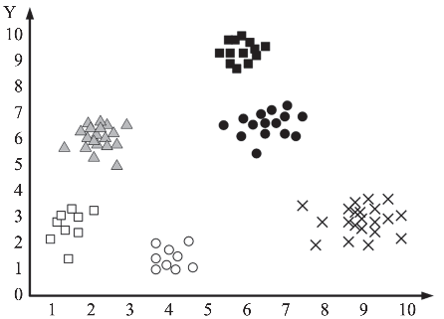
k-means Clustering
x₂
x₁

Slide 73
We want k=2 clusters. Randomly pick 2 data points as cluster centers
c1
c2

Slide 74
Assign each data point to the cluster center closest to it. Here, C1 is closer to all the blue nodes than C2…
c1
c2

Slide 75
… and C2 is closer to all the red nodes than C1.
c1
c2

Slide 76
Calculate new centroids for each cluster based on the current membership
c1
c2

Slide 77
Revise cluster assignments: assign each data point to the cluster with the nearest centroid
c1
c2

Slide 78
Update centroids for each cluster based on the current membership
c1
c2

Slide 79
No further changes happen – algorithm converges
c1
c2

Slide 81
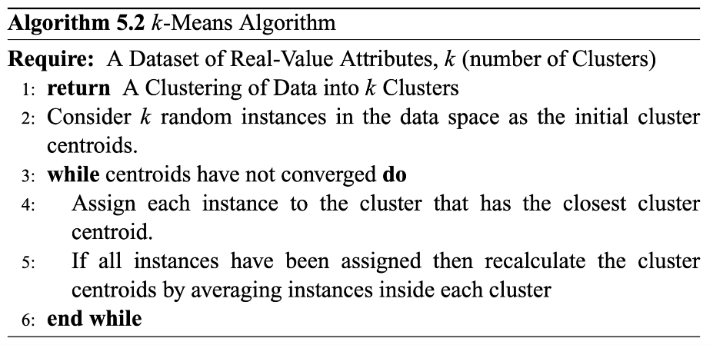

Slide 82
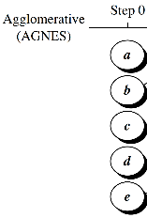
Hierarchical Clustering

Slide 83
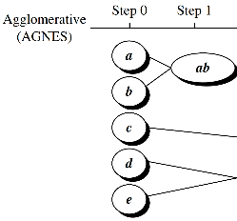

Hierarchical Clustering

Slide 84
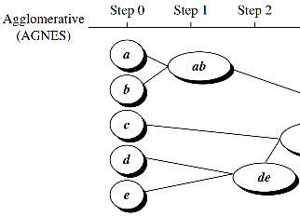

Hierarchical Clustering

Slide 85
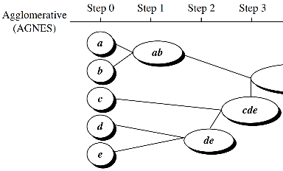
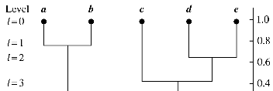
Hierarchical Clustering

Slide 86
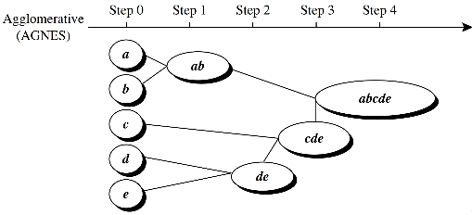
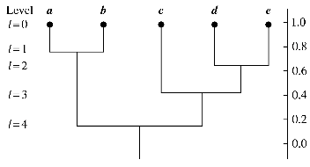
Hierarchical Clustering

Slide 87
Hierarchical Clustering

Slide 88
Hierarchical Clustering

Slide 89
Hierarchical Clustering

Slide 90
Hierarchical Clustering

Slide 91
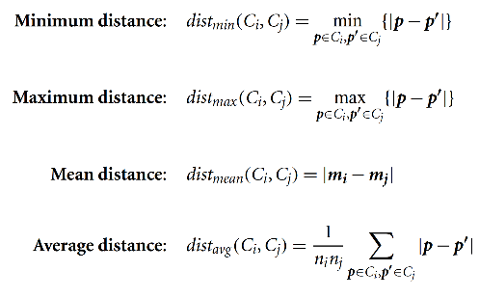
Hierarchical Clustering
|p - p’| is the distance between two data points, p and p’
m_{i} is the mean for cluster, C_{i}
n_{i} is the number of data points in C_{i}

Slide 92
Clustering
k-means clustering
Hierarchical clustering
DBScan

Slide 93
Social Science
Network Science
Social Media Mining
Statistics and Data Mining

Slide 94
References
Data Mining: Concepts and Techniques, 3rd edition, by Jiawei Han, Michelin Kamber, and Jian Pei

Slide 95
Summary

